Slide 1
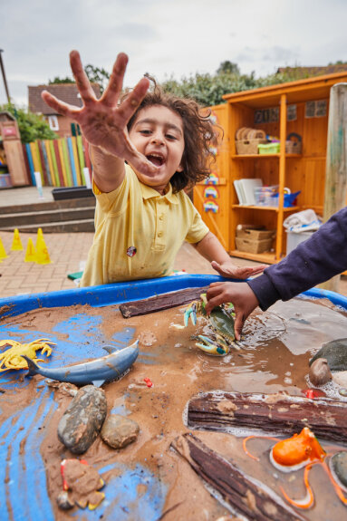
Welcome to Heronshaw School
Inspire-Grow-Achieve

Slide 2
Heronshaw Values
Success
Our core values are explored, celebrated and weaved through our Curriculum. Through our values we aim to build determined, respectful and responsible citizens able to contribute to their school and wider community.
Challenge
Community
Honesty
Friendship
Kindness
Respect
Notes:
A little bit about our school…these are our 7 values that we promote throughout our school.
We share and teach these to the children through our assemblies and circle times. We also reward children points on our behavior trackit lights system when they show these. These values link closely to the EYFS values. We celebrate the successes as a whole school

Slide 3
Year 1 Classes
Mrs Moor
Mrs Langford
& Mrs Thompson
Mrs Bolger
& Mrs Batey
Notes:
Team working with the children and you will see around

Slide 4
Year 2 Classes
Mrs Ravilious
Mrs Calder
Mrs Zastron
Notes:
Team working with the children and you will see around

Slide 5
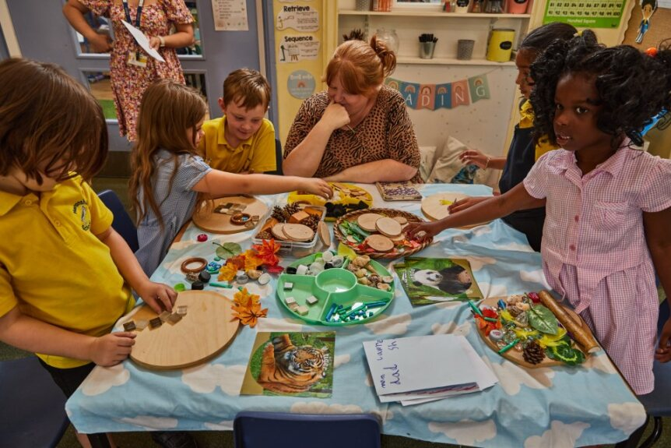
Heronshaw Curriculum
Notes:
Our learning environment is organised into areas of continuous provision providing the children with opportunities for child-initiated learning both indoors and outdoors. Our learning environments are designed to promote independence and curiosity. The learning environments are carefully enhanced to ensure that children can practise and apply. The adults will share ideas, set uncapped challenges and support and scaffold where appropriate ‘in the moment’

Slide 6
CURRICULUM STRUCTURE
At Heronshaw School our aim is to provide our children with:
An inspiring, creative and empowering curriculum that is aspirational for all
Our curriculum content has been carefully mapped to ensure that knowledge is built on throughout their journey through Heronshaw school.
This knowledge is revisited at spaced intervals to ensure skills are revisited over time, in order for learning to take place.
Notes:
Our learning environment is organised into areas of continuous provision providing the children with opportunities for child-initiated learning both indoors and outdoors. Our learning environments are designed to promote independence and curiosity. The learning environments are carefully enhanced to ensure that children can practise and apply. The adults will share ideas, set uncapped challenges and support and scaffold where appropriate ‘in the moment’

Slide 7
Heronshaw Curriculum
Our curriculum also designed to:
Build on children’s prior learning and move them on to new skills
Provide creative and experiential first- hand learning experiences, enrichment opportunities and challenges to engage learning
Allow the children to develop interpersonal skills and build resilience.
Develop their intellectual curiosity, critical thinking, leadership and independence.
Develop our children's cultural capital through our Heronshaw values; kindness, community, friendship, challenge, success, respect and honesty.
Develop the whole child and provide opportunities for learning beyond those of the children’s every day experiences
Notes:
Our learning environment is organised into areas of continuous provision providing the children with opportunities for child-initiated learning both indoors and outdoors. Our learning environments are designed to promote independence and curiosity. The learning environments are carefully enhanced to ensure that children can practise and apply. The adults will share ideas, set uncapped challenges and support and scaffold where appropriate ‘in the moment’

Slide 8
Heronshaw Curriculum
Year 1
Autumn 1 | Autumn 2 | Spring 1 | Spring 2 | Summer 1 | Summer 2
Can we zoom to the moon? | Near, far, wherever you are | What lies beneath | What's in a toy box? | How can you defend your castle? | Rumble in the jungle
Year 2
Autumn 1 | Autumn 2 | Spring 1 | Spring 2 | Summer 1 | Summer 2
Who is hungry? Harvest | Women who Dared to Discover | Whose planet is it anyway? Our world – environment focus | Who burnt the bread? The Great Fire of London | Iceberg Ahead! Titanic | Summer 2 Amazing Africa Africa
Notes:
Our learning environment is organised into areas of continuous provision providing the children with opportunities for child-initiated learning both indoors and outdoors. Our learning environments are designed to promote independence and curiosity. The learning environments are carefully enhanced to ensure that children can practise and apply. The adults will share ideas, set uncapped challenges and support and scaffold where appropriate ‘in the moment’

Slide 9
Heronshaw Curriculum
Notes:
Our learning environment is organised into areas of continuous provision providing the children with opportunities for child-initiated learning both indoors and outdoors. Our learning environments are designed to promote independence and curiosity. The learning environments are carefully enhanced to ensure that children can practise and apply. The adults will share ideas, set uncapped challenges and support and scaffold where appropriate ‘in the moment’

Slide 10
KS1 Maths
Here at Heronshaw we follow a mastery approach to teaching maths.
Maths mastery is a teaching and learning approach that aims for pupils to develop deep understanding of maths rather than being able to memorise ways of solving equations.
The end goal and expectation is for all pupils to have acquired the fundamental facts and concepts of maths through building a whole new culture of deep understanding , confidence and competence in maths.
We do not move through stages of learning before we have mastered a subject.
Mastery of a mathematical concept means a child can use their knowledge of the concept to solve unfamiliar word problems, and undertake complex reasoning, using the appropriate mathematical vocabulary.
Notes:
Team working with the children and you will see around

Slide 11
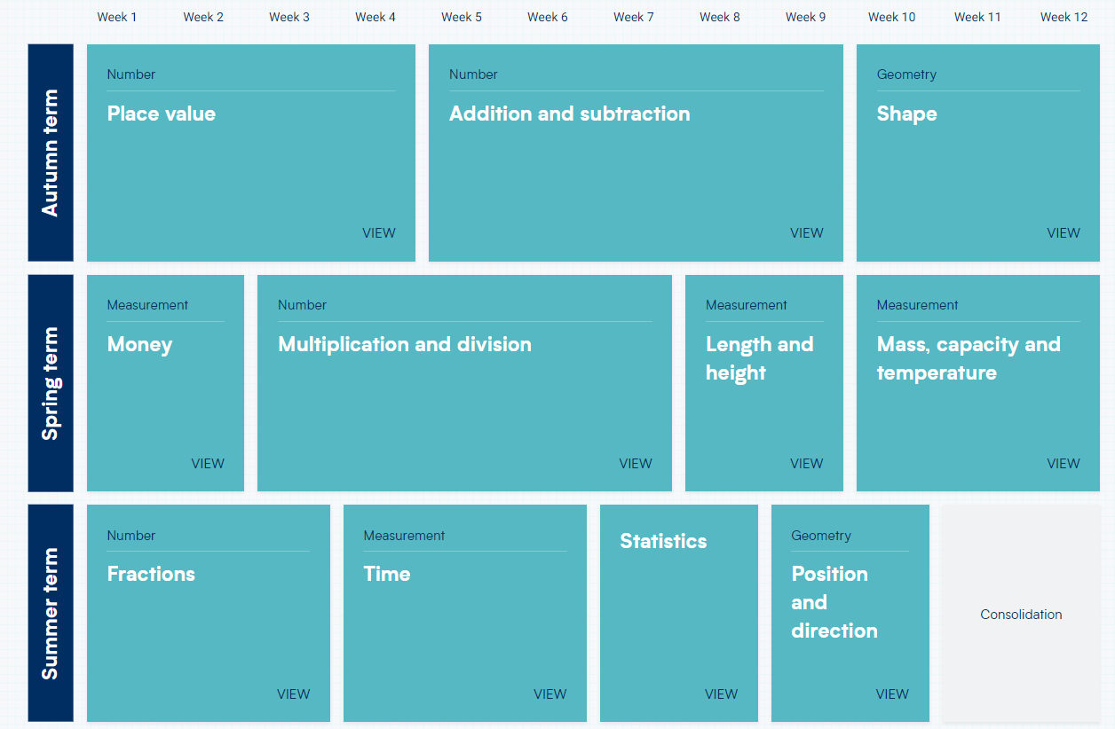
What does maths look like in KS1? We follow this approach with support from the Whiterose scheme of work alongside the guidelines from the government ready to progression documents.
We have used the Whiterose medium term planning with the steps to progress document to create a bespoke schemes of learning for our children.
Notes:
Team working with the children and you will see around

Slide 12
Notes:
Team working with the children and you will see around

Slide 13
Children will be taught through:
Direct instruction
Using relevant real-life examples and mathematical models and
images to develop secure conceptual understanding.
Practical activity, exploration and discussion.
Using mathematical ideas
Quality questioning and supported discussion
Carefully designed variation
A school-agreed calculation policy.
Using a robust assessment system
Notes:
Team working with the children and you will see around

Slide 14
CPA Approach
All children begin their lessons using concrete resources to support their conceptual understanding.
This is then followed by a pictorial representation, followed by the abstract, where children are encouraged and supported to make recordings of their learning.
Notes:
Team working with the children and you will see around

Slide 15
Ofsted "Know more, do more, remember more"
Notes:
Team working with the children and you will see around

Slide 16
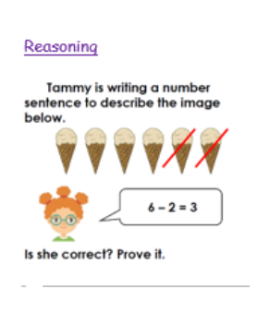
Problem solving and reasoning. ​ As part of our mastery approach, when children have finished their independent practice they have the opportunity to deepen their knowledge through problem solving and reasoning. They are encouraged to write in full sentences and articulate how they know an answer
Notes:
Team working with the children and you will see around

Slide 17
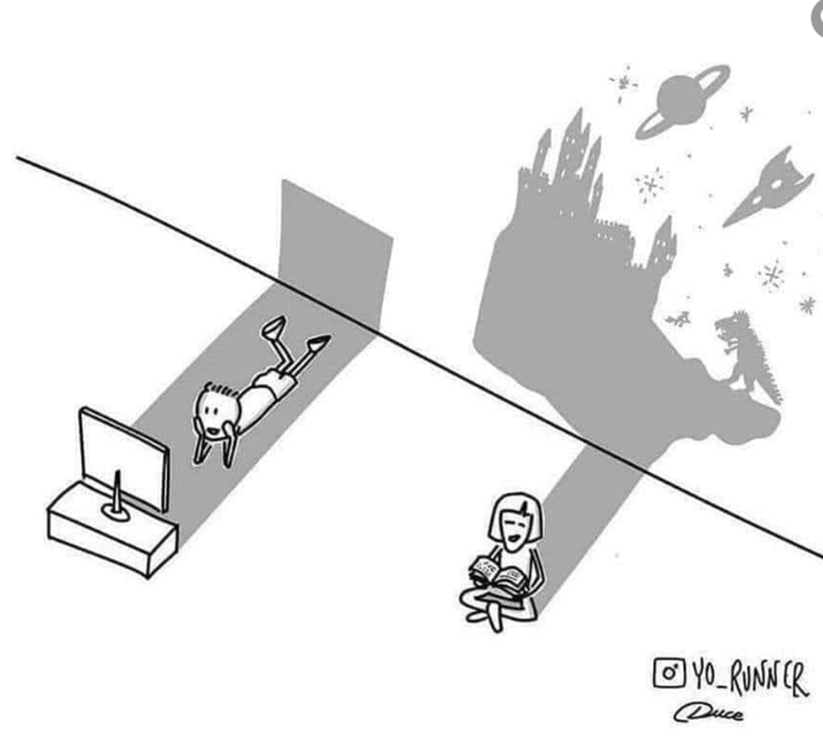
Book Talk and reading at Heronshaw
Notes:
Team working with the children and you will see around

Slide 18
Notes:
Team working with the children and you will see around

Slide 19
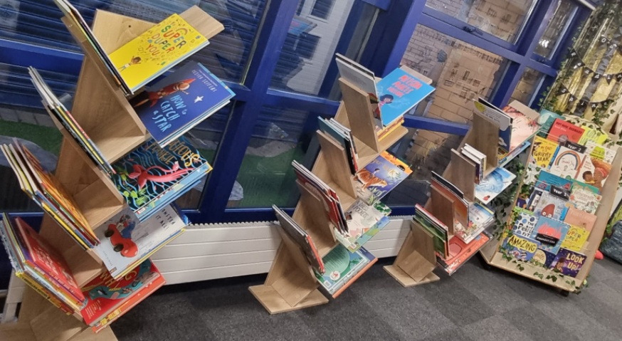
Our reading promise…
At Heronshaw we promise to inspire and enrich children’s vocabulary and immerse them into a text rich environment within the school. To grow and develop this further our ever-evolving reading spine and year group reading trees offer a range of books to ignite discussion in the classroom. These books reflect important topics in our community and wider society, with many focusing on the 9 protected characteristics; allowing a diverse and rich range of texts to be shared in class. A daily timetabled 'story time' slot enables our children to share a calming, thought provoking story; learning not only to enjoy reading alone, but being read to; achieving the culture of ‘just one more page/ chapter’ from each child.
Notes:
Team working with the children and you will see around

Slide 20
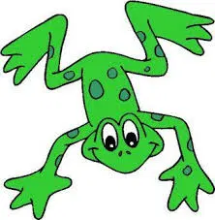
Read Write Inc. provides a structured and systematic approach to teaching phonics. Children in Foundation Stage and KS1 take part in a 30 minutes Phonics lesson every day.
First the children are taught one way of representing the 44 main sounds and then go on to learn the alternative spelling.
Read Write Inc. introduces the simple Speed Sounds (one sound, one grapheme) with Speed Sounds Set 1 and Set 2. They then learn more ways of writing the same sounds with the complex Speed Sounds Set 3 (e.g. they will be taught the sound ‘ay’ as in ‘play’ and they will then look at the sound ‘a-e’ as in ‘cake’ which is the same sound, different spelling)
Once children know the first set of Speed Sounds, they are ready to read the first Storybooks.

Slide 21
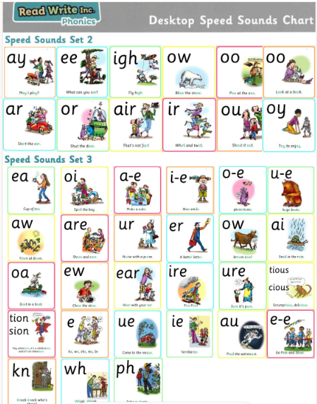

Slide 22
Teach Set 1 sounds up to Red level
Review Set 1 sounds and teach Set 2 sounds up to purple level
Review Set 2 sounds and teach Set 3 sounds from Pink level
‘Off the programme’ – children above grey will move on to ARE books.
At Heronshaw we love different authors so have chosen our 3 categories after 3 well loved authors: Julia Donaldson, Oliver Jeffers and J K Rowling.

Slide 23
Reading in KS 1
At Heronshaw we promote the love of reading. Each classroom has an inviting reading area for the children to access in the form of their own mini library.
Each child takes home a reading book which matches their phonics level. They need to read this at least 3 times for decoding, fluency and comprehension.
All children on Red level and above get their own bookmark to keep which has all the RED words for that level. These are words that can't follow phonics sounds. Please practice these at home as well.
As your child moves up their phonics level they shall achieve their coloured phonics group certificate!

Slide 24
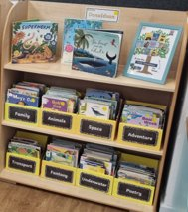
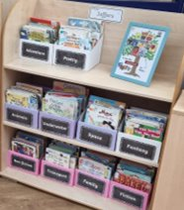
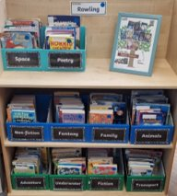
Reading in KS1
‘Donaldson’ bookcase; all books with a yellow sticker. Children should enjoy the freedom of choice and look to build their stamina and fluency with this range of books.
‘Jeffers’ collection, marked with silver stickers. Longer words and sentences. Longer stories and paragraphs to progress on from Donaldson.
'Rowling’ marked with blue stickers. Comprehensive chapter books that require confidence, pace and fluency from the reader.
The teacher will give guidance to the books being picked, but to ensure freedom of choice children will be able to select any of the ARE (age related expectation) texts. This enhances the reading for pleasure ethos that we have at Heronshaw.
These books can be changed Tuesday and Friday.

Slide 25
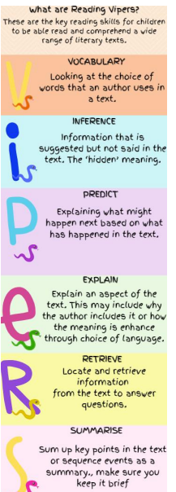
Reading Records
Please fill in your child's reading record, with a simple initial to show they have read at home every day!
​
Each week your child's reading record will be checked and they shall we awarded stars to build towards their reading star certificates.
Every 5 reads they will be entered into a raffle to win a reading prize twice a term!​
Support your child's reading by posing questions about the book; some questions are on the VIPERS bookmarks.

Slide 26
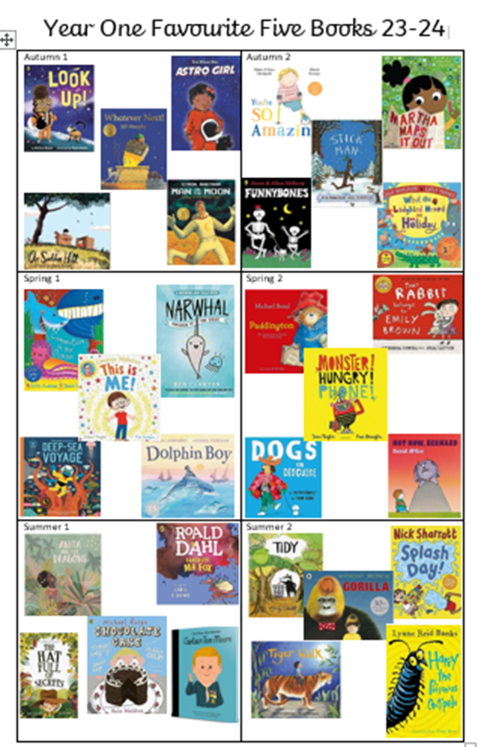
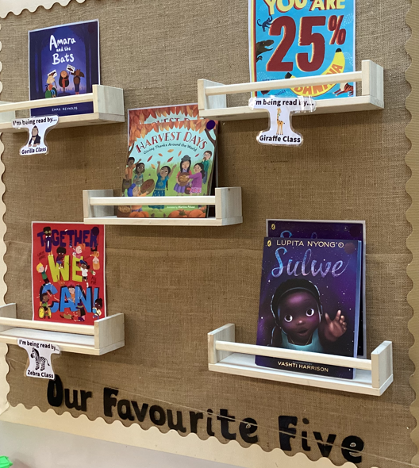
Story time Our Favourite Five
O
Every day children enjoy a story time. This year we have dedicated 30 stories to our year group 'favourite five' to read, talk and discuss during our story time. These are high quality books focusing on 'a big idea'.
These will be repeated, focusing on different aspects of the text.
90, carefully selected books, that children will know and love by the end of Heronshaw.

Slide 27
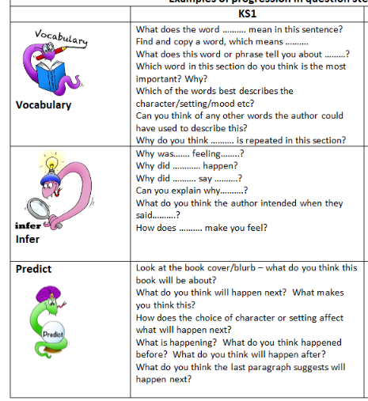
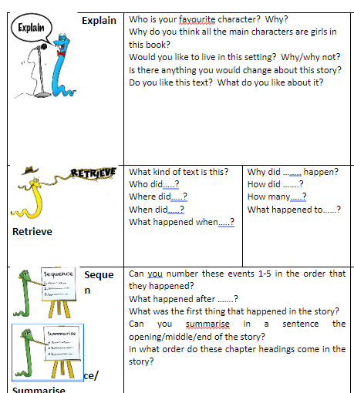
O

Slide 28
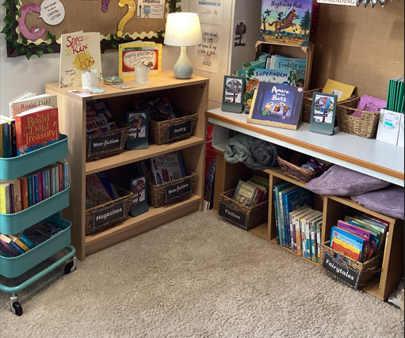
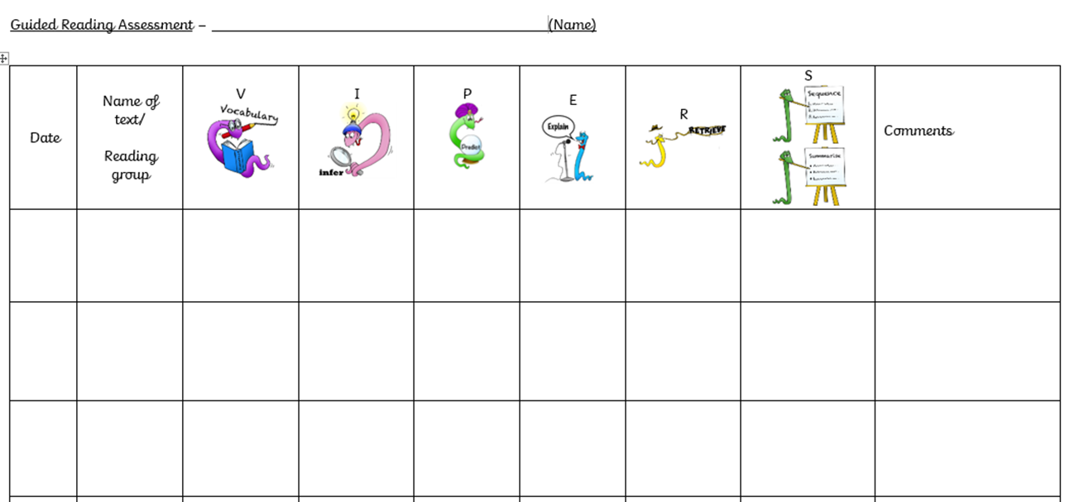
Book Talk
As part of our daily timetable KS1 do 'Book Talk' where children are exposed to different fiction, non-fiction and poetry texts.
Each week a section of text is read, explored as a class through VIPERS questioning, children read independently and to their partners. They then have a comprehension activity to demonstrate their understanding of the book and at the end of the week we celebrate being a reader by sharing book reviews, comparisons of authors, genres and bring in and read a variety of texts to broaden our children's world of reading.
O

Slide 29
What more you can do at home:
We ask that you read your child’s reading book with them 3 times.
Please support your child’s reading progress by listening to them read at least 5 times a week as this will build confidence, fluency and intonation through reading; essential in becoming a strong reader.
Make reading enjoyable – cosy up and create a quiet time for this.
Create a love of books – read stories to them and visit the school library and local libraries in MK.
Ensure your child has their reading book and reading record in school every day.
You can inspire reading outside of school further by listening to audiobooks.
Read a book together ahead of enjoying the movie.
Read books TO your child and enjoy them together.
Visit your local library and book shop.
Reread the same books to your child; encouraging them to join in with repeated words/ phrases.
Most importantly it’s important to embed reading as part of your daily routine; 10 minutes before bed.
O

Slide 30
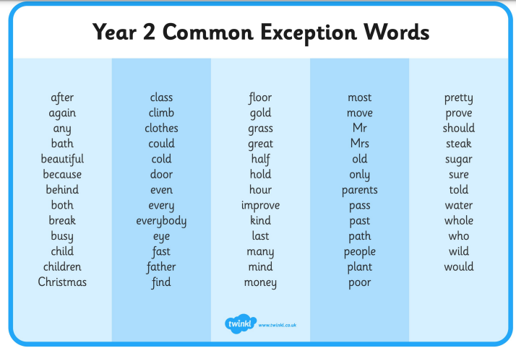
KS 1 Common Exception Words
Common exception words are everyday words that break the phonic rules taught at school. ... They are words that appear frequently in texts and that help readers understand what they are reading.
Year 1 Year 2

Slide 31
SPaG
During Phonics children will do SPaG - this stands for 'Spelling, punctuation, and grammar'. This is a crucial building block for children learning to speak, write, and listen. Having a good knowledge of grammar allows your child to communicate their ideas and feelings and helps them choose the right language for any situation.
In KS1 children will learn a variety of key writing skills:
using capital letters, full stops, question marks, and exclamation marks
turning nouns into their plural form using -s and -es
adding suffixes to verbs where no change is needed in the spelling of the root word (for example, helping, helped, helper).
Expanded noun phrases, use of suffixes to create adverbs, apostrophes for possession and contraction. Using co-ordinating and sub-ordinating conjunctions along with time adverbials.
O

Slide 33
Notes:
Team working with the children and you will see around

Slide 34
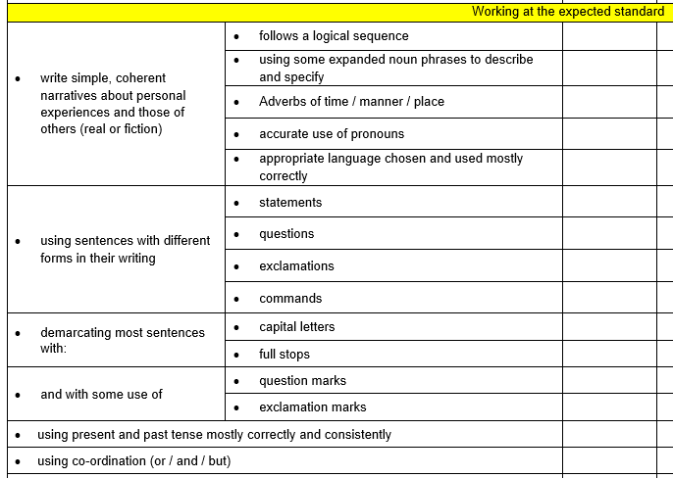
Year 2 Writing
Notes:
Team working with the children and you will see around

Slide 35
Our Lenses
Notes:
Team working with the children and you will see around

Slide 36
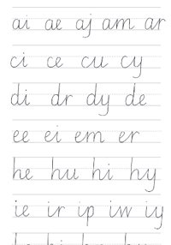
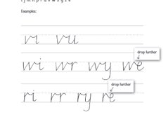
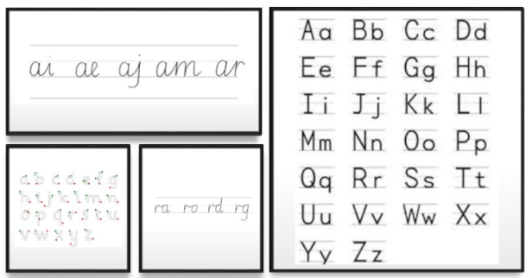
Year 1 children will need to form their letters properly (correct start point and size of letters) before they are able to learn to join up their writing.
Notes:
Team working with the children and you will see around

Slide 37
School Clubs
Heronshaw school offers a wide range of after school clubs to all of our children.
A lot of the clubs that we provide are of children's interest and we are always changing the clubs half termly to engage children to gain new experiences and skills. The clubs have been very beneficial to children's self-confidence and self-esteem as well as keeping them healthy and active.
Opportunities have been created for children to build relationships with their peers through teamwork and social interaction leading to strong friendship groups. The social interaction boosts communication skills as children work together to achieve the same goal.

Slide 38
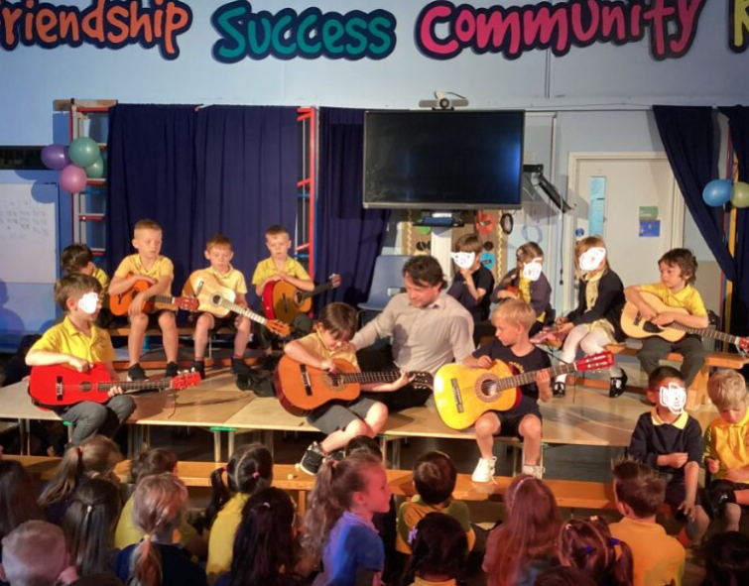
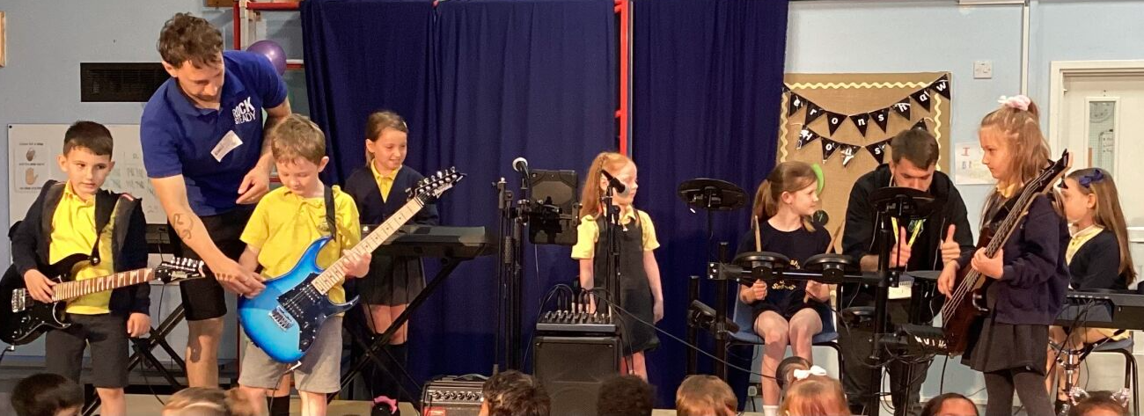
Music at Heronshaw
Strum – into – Music
Guitar lessons

Slide 39
Homework:
Year 1:
This term year 1 will be focusing on reading as homework every day and then look at introducing spellings in Spring term. The children will also have logins for Numbots to support their maths fluency.
Year 2:
Reading is still a high priority and we encourage children to read every day. Homework books will be sent out on a Friday every week. Homework will be a set of spellings (based on spelling patterns.) Then there will be some maths problem solving and reasoning based on what the children have been learning during the week. Homework is to be returned on a Wednesday.

Slide 40
Heron Mail: How to keep in touch

Slide 41
Attendance
The school day (opening hours)
Statutory hours (children expected to be in school) from 08:30 until 15:10 (Monday to Friday). *32.5 statutory hours per week.
Children are expected to be in school every day. At Heronshaw we work hard to ensure this is the case for all children. As we are sure you are aware that children who come to school regularly make far better progress.
Anyone who does not come to school for whatever reason, should call in to the office on a daily basis (by 8.40am latest where it will be decided if the absence is authorised or unauthorised).
Attendance is monitored weekly.
If your child’s attendance drops below 96% you will receive a letter encouraging you to work with the school to improve it. This is referred as being 'at risk of persistent absence’.
Attendance that drops below 90% is persistent absence. We monitor these cases under 'Attendance Watch' and a meeting with school will be arranged to set short term actions and to discuss support.
We hope to work closely with you, in order to ensure your child makes the best progress and takes full advantage of the opportunities offered to them.

Slide 42
COMMUNICATION
Teacher at the door
My Child At School (MCAS)
All parents who want to receive communication need to download and sign up for this.
Website for all main information
Social Media (Are you following us?)
Facebook
Twitter
Notes:
Children enter through foundation gate – times to be confirmed/clarified. Children will have coat pegs and labels for coats. Water bottle box
3 animals in foundation – lions, crocs and bears
We provide healthy snack for children
And milk is provided for children until they turn 5 then you need to book through cool milk if you wish them to have it.

Slide 43
MCAS – My Child At School Every parent can add it and get updates
School ID: 13028
Invitation Code: emailed out but also on list at school
Username: emailed out but also on list at school
Alerts, dates, updates all coming through MCAS

Slide 44
Governors & PTA
Notes:
Children enter through foundation gate – times to be confirmed/clarified. Children will have coat pegs and labels for coats. Water bottle box
3 animals in foundation – lions, crocs and bears
We provide healthy snack for children
And milk is provided for children until they turn 5 then you need to book through cool milk if you wish them to have it.

Slide 45
Year 2 Futures
Notes:
Children enter through foundation gate – times to be confirmed/clarified. Children will have coat pegs and labels for coats. Water bottle box
3 animals in foundation – lions, crocs and bears
We provide healthy snack for children
And milk is provided for children until they turn 5 then you need to book through cool milk if you wish them to have it.

Slide 46
END
Notes:
Children enter through foundation gate – times to be confirmed/clarified. Children will have coat pegs and labels for coats. Water bottle box
3 animals in foundation – lions, crocs and bears
We provide healthy snack for children
And milk is provided for children until they turn 5 then you need to book through cool milk if you wish them to have it.

